Slide 1
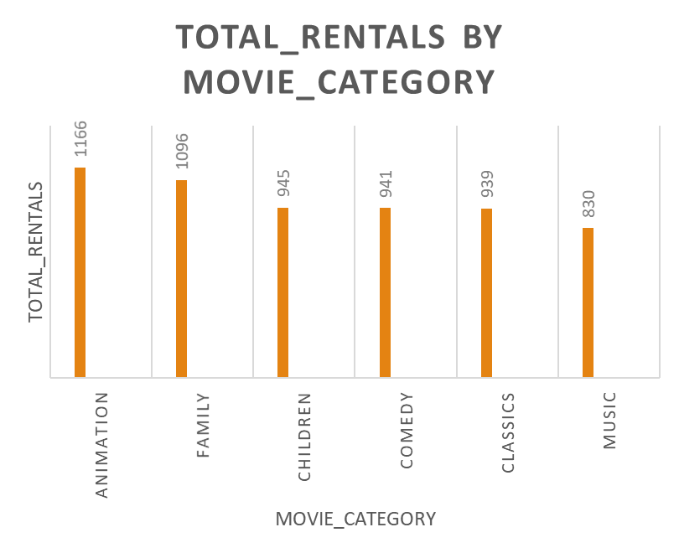
TOTAL NUMBER OF RENTALS BY MOVIE_CATEGORY FOR FAMILY FRIENDLY MOVIES
QUERY
See Q1.sql
INSIGHTS
1. Family movies in the animation category had the highest rentals.
2. The lowest rentals was observed in family movies that belongs to the ‘music’ category.

Slide 2
MOVIES WITH THE HIGHEST RENTAL DURATION (4TH QUARTILE) IN THE FAMILY FRIENDLY MOVIE CATEGORIES
QUERY
See Q2.sql
INSIGHTS
1. Movie with film_id 767 had a rental duration of 6 days
2. Movie with film_id 962 had a rental duration of 7 days
3. The highest rental duration for movies in the family friendly category is 7 days
4. From the data, the lowest rental duration for movies in the family friendly category is 3 days

Slide 3
STORE WITH THE HIGHEST RENTAL ORDERS BY YEAR
QUERY
See Q3.sql
INSIGHTS
Store 1 had the highest rental orders in 2005
Store 2 had the highest rental orders in 2006, although this is not so significant considering the duration of the data set.

Slide 4
TOTAL PAYMENT AMOUNT FOR EACH MONTH BY TOP 10 PAYING CUSTOMERS IN 2007
QUERY
See Q4.sql
INSIGHTS
ELEANOR HUNT is the highest paying customer with a total payment of $211.55 between the second and fifth month, followed closely by Karl Seal with total payment of $208.58

